Slide 1
Selling & Delivering Image-Pro v11
Distribution Partner Training
CONFIDENTIAL

Slide 2
Agenda
Pricelist 2023
Ordering Updates
Your my.mediacy.com Account
Shop & Deliver
Additional Documentation
CONFIDENTIAL

Slide 3
Pricelist 2023
CONFIDENTIAL

Slide 4
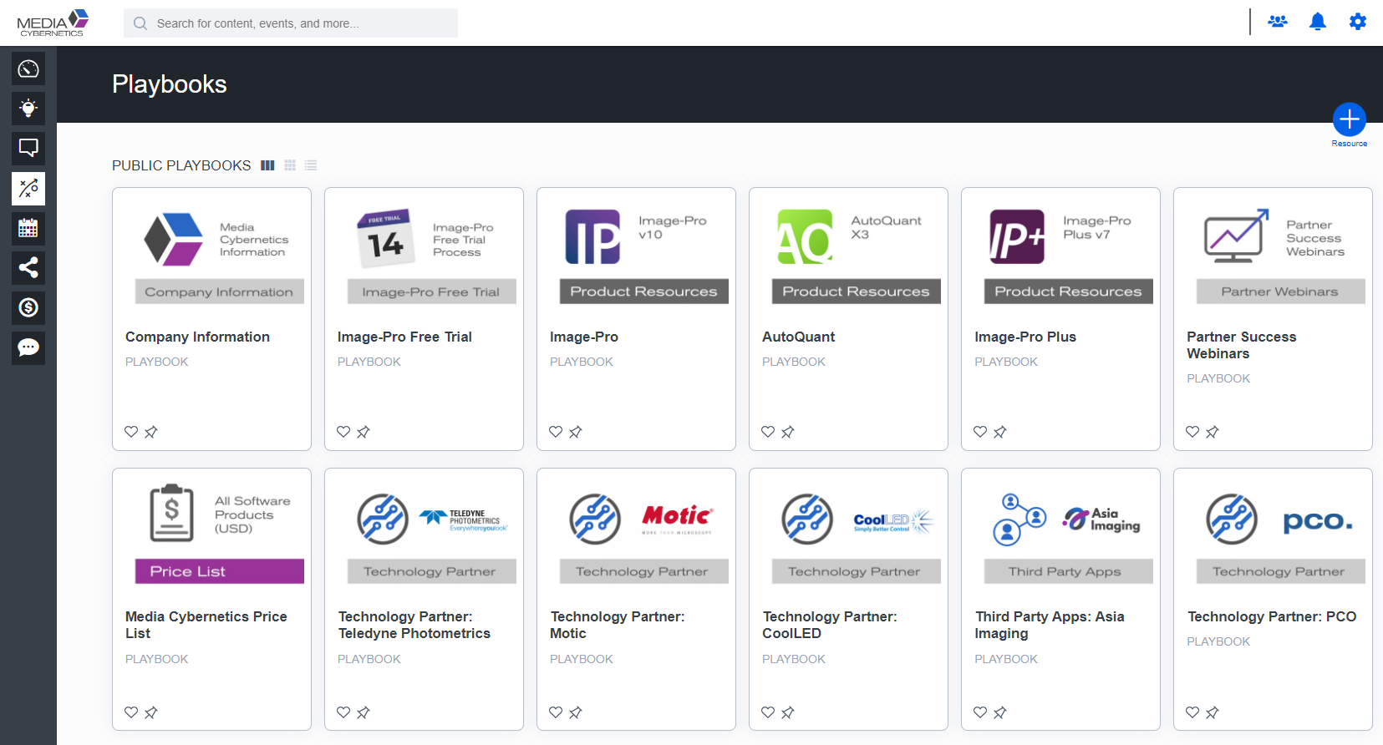
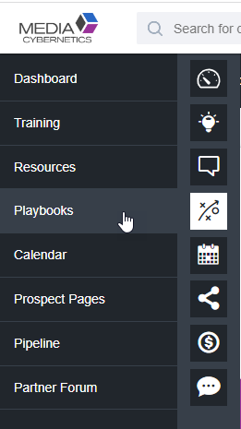
New 2023 Price List
https://partner.mediacy.com
CONFIDENTIAL

Slide 5
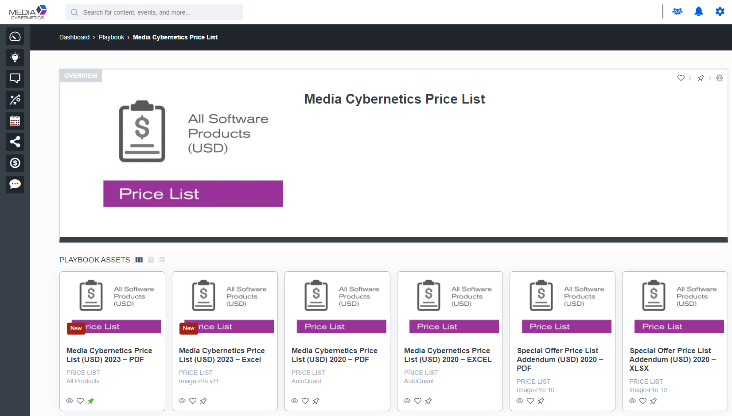
New 2023 Price List
CONFIDENTIAL

Slide 6
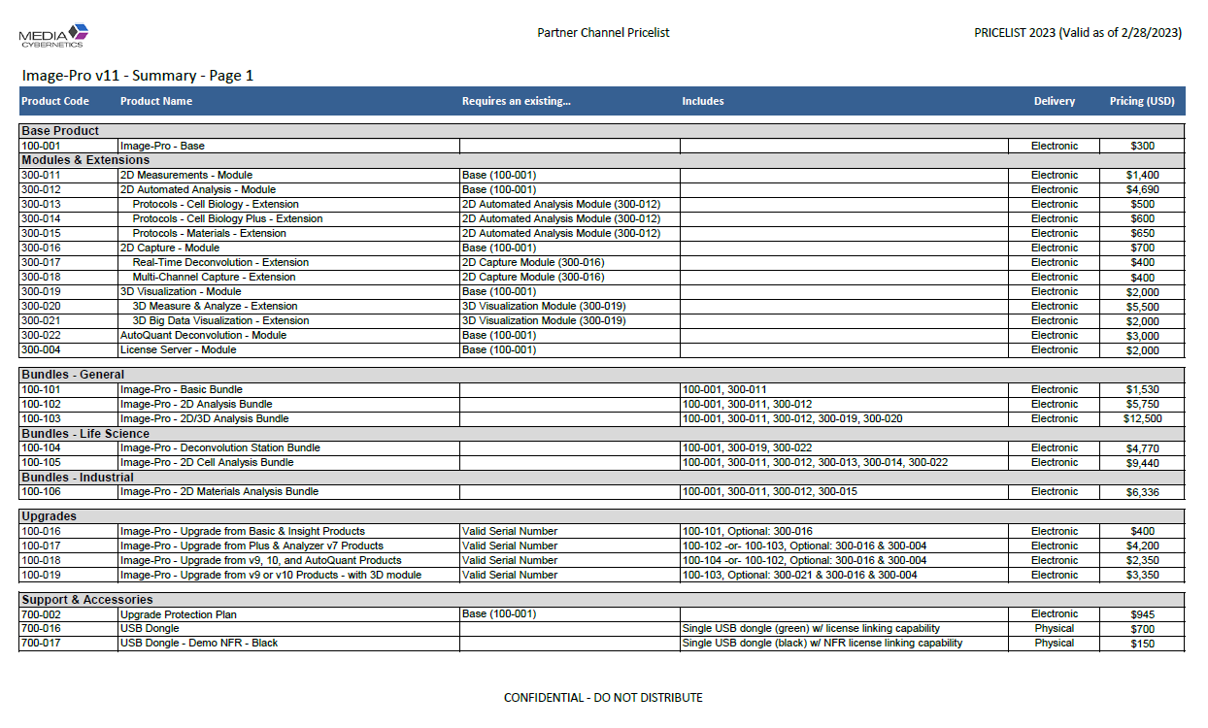
New 2023 Price List
v11 Take Aways
p1 contains ALL v11 part #’s
p2-5 repeats and shows descriptions
All Software Products are Electronic Delivery ONLY
USB Dongles are Optional
v7 Take Aways
p6 only
102-001 - Image-Pro Plus v7 - USB Dongle
102-005 - Image-Pro Analyzer v7 - USB Dongle
700-015 - Replacement Dongle NEW
Supports v7 – v10 & AQX3
NOT for v11
CONFIDENTIAL

Slide 7
New 2023 Price List
Retired Part #s
All Image-Pro v10
All AutoQuant X3
Last Day to Quote: Tues, February 28th 2023
Grace Period - for Retired Part Orders
3 Months
Last Day Accepted: Wed, May 31st, 2023
Requirements - for Retired Part Orders
Must send in a Purchase Order (PO) document to orders@mediacy.com
Must provide a Quotation dated on or before Feb 28th, 2023
CONFIDENTIAL

Slide 8
Example Quotations
Customer Need |  | How to Quote
Same product config as v10 |  | [100-102] Image-Pro – 2D Analysis Bundle @ $5,750
A single Protocol from the Cell Biology Collection |  | Option 1) $5,490 [100-001] Image-Pro – Base @ $300 [300-012] 2D Automated Analysis – Module @ $4,690 [300-013] Protocols – Cell Biology – Extension @ $500 Option 2) $9,440 [100-105] Image-Pro – 2D Cell Analysis Bundle Image-Pro – Base 2D Measurements – Module 2D Automated Analysis – Module Protocols – Cell Biology – Extension Protocols – Cell Biology Plus– Extension
CONFIDENTIAL

Slide 9
Example Quotations
Customer Need |  | How to Quote
Same product config as v10 Basic |  | [100-101] Image-Pro – Basic Bundle @ $1,530
2 floating licenses: 1 Fluorescent Capture Station 1 Cellular Analysis Station |  | [100-001] Image-Pro – Base @ $300 [300-016] 2D Capture – Module @ $700 [300-018] Multi-Channel Capture – Extension @ $400 [300-017] Real-Time Deconvolution – Extension @ $400 [100-001] Image-Pro – Base @ $300 [300-012] 2D Automated Analysis – Module @ $4,690 [300-013] Protocols – Cell Biology – Extension @ $500 [300-004] License Server – Module @ $2,000 Total = $9,290
CONFIDENTIAL

Slide 10
Example Quotations
Customer Need |  | How to Quote
Cost-effective 3D Visualization and Analysis |  | [100-001] Image-Pro – Base @ $300 [300-019] 3D Visualization – Module @ $2,000 [300-020] 3D Measure & Analyze – Extension @ $5,500 Total = $7,800
A Capable Materials Inspection Software |  | [100-106] Image-Pro – 2D Materials Analysis Bundle @ $6,336
CONFIDENTIAL

Slide 11
Upgrades
Existing |  |  |  | Bundles |  |  |  | Modules
 |  |  |  | Basic | 2D Analysis | 2D/3D Analysis | Decon Station | Big Data Vis | Capture | License Server
Base Product | Options |  | Part # |  |  |  |  |  |  |  | Price
Image-Pro Basic v10 Image-Pro Insight v8 - 9 | Capture | → | 100-016 | ✓ |  |  |  |  | O |  | $400
Image-Pro Plus v7 Image-Pro Analyzer v7 | Capture (a) Network (a) 3D (b) | → | 100-017 |  | ✓ª | ✓^{b} |  |  | O | O | $4,200
Image-Pro Premier v9.x (a) Image-Pro v10 (a) AutoQuant (b) | Capture (a) Network (a) | → | 100-018 |  | ✓ª |  | ✓^{b} |  | O | O | $2,350
Image-Pro Premier 3D v9.x Image-Pro v10 with 3D Module | Capture 3D Big Data Network | → | 100-019 |  |  | ✓ |  | O | O | O | $3,350
CONFIDENTIAL

Slide 12
Upgrade FAQs
Does upgrading to v11 affect an existing v10 license?
No, they will be installed side-by-side
What if a customer has an existing App?
All MediaCy created Apps are now Free on the App Center https://mediacy.com/app-center/
What if a customer has v9 or v10 with Colocalization?
v19 or v10 will continue to function. In v11, the feature has been moved to a Protocol and must be purchased separate using [300-014]. It is not included in the upgrade.
What if a customer wants to upgrade with a Network License?
Upgrades have an optional License Server that can be included with the upgrade at no extra charge.
NOTE: The new License Server is NOT compatible with older v10 Network Licenses
CONFIDENTIAL

Slide 13
Upgrade FAQs
What if a customer wants to upgrade an AutoQuant license?
They can upgrade to the Deconvolution station [100-104]
What if a customer wants to upgrade their Image-Pro Plus v6?
Must purchase a new license of Image-Pro v11
Versions older than v7 are no longer eligible and must purchase a new license
CONFIDENTIAL

Slide 14
Ordering Updates
As of 2/28/2023
CONFIDENTIAL

Slide 15
How to Order
YES | NO
my.mediacy.com/shop | Send Purchase Order www.imageproshop.com
EXCEPTION: Send POs for Retired Part #s until May 31st
CONFIDENTIAL

Slide 16
How to Pay
Credit Card
Must pay through my.mediacy.com account
ACH / Wire
Must cover all Wire Fees. Do NOT pass along to MediaCy
Mail Checks
1700 Rockville Pike, Suite 240, Rockville, MD 20815
New suite # in Oct 2023!!
CONFIDENTIAL

Slide 17
Your
my.mediacy.com
Account
CONFIDENTIAL

Slide 18
Benefits (to Partner)
One location with all your End Users
Visibility to product purchases over time
Self-service distribution of Trial Licenses to End Users
One location to manage NFR Demo Licenses
One location with all your Support Tickets
Easy team setup to share licenses and tickets across the team
Access to all Orders and Invoices
Visibility of Invoice Payment status and easy Credit Card payment
Optional benefit of working with “Sub Partners”

Slide 19
my.mediacy.com
How to get a Partner account?
Media Cybernetics must create all Partner accounts
and send you an invitation email
When?
Starting week of March 6th
CONFIDENTIAL

Slide 20
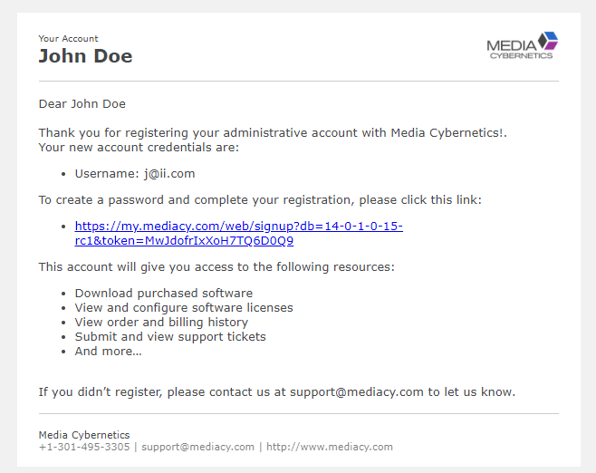
my.mediacy.com
CONFIDENTIAL
Notes:
Email Invitation that is sent to Partner. You only need to click the link.

Slide 21
my.mediacy.com
CONFIDENTIAL
Notes:
Link will take a Partner to this page to enter password

Slide 22
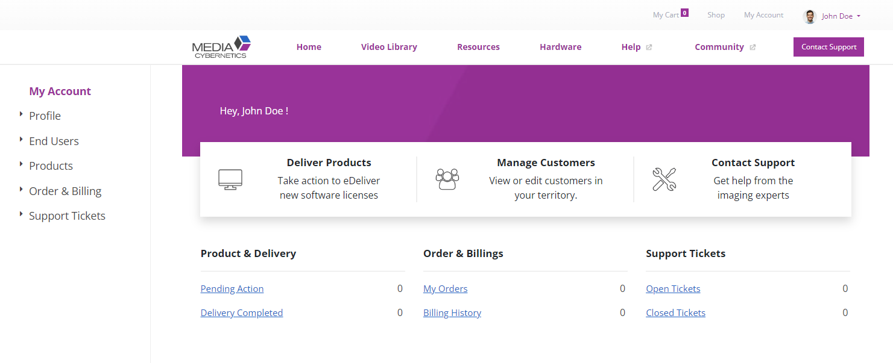
my.mediacy.com
Partner Only
Same as End User View
CONFIDENTIAL
Notes:
After first login, a Partner will see this page. The second menu row (next to the logo) is static for all my.MediaCy pages, whether an End User or Partner, signed in or not. The top menu row (in the top right corner) is for account links. The Shop and MyCart will ONLY show for Partners as End Users do not have the option of purchasing through the Shop directly.

Slide 23
Notes:
This video shows a brief overview of each section on the myMediaCy site for partners.

Slide 24
Shop & eDeliver
CONFIDENTIAL

Slide 25
Shopping & eDelivery
Invite End User to Register for Account
Shop for Products & eDeliver to your Account
eDeliver Products to Registered End User Admin
CONFIDENTIAL
Notes:
We are recommending that End Users be invited early so they have time to register and get familiar with their new account before products are eDelivered.

Slide 26
Demo Accounts
Partner
End User
Imaging Integrator Inc
Gold Distribution Partner
Industrial Research LLC
Materials Inspection Company
John Doe
Sales Manager
Email/User: j@ii.com
Jane Smith
Engineer
Email/User: j@ind.com
CONFIDENTIAL
Notes:
Today we are going to use a TEST Partner and a TEST End User for our training example.

Slide 27
Step 1 Invite End User to Register for Account
CONFIDENTIAL

Slide 28
Inviting End User
1
2
3
4
Go to
Contacts Page
Click
Add Contact
Send Invite Email
Partner
Fill in Form
End User
Click Link
in Email
Click Register
to Sign-In
Fill in Form
End User
Status
“Send Invite” button
Pending Acceptance
Active

Slide 29
Who to Invite?
Only the Admin.
CONFIDENTIAL
Notes:
Only invite the Admin, let them invite the other users to their team.
Each Admin will manage their own licenses.

Slide 30
CONFIDENTIAL
Notes:
In this video, the partner adds a new End User Contact. First they go to End Users > Contacts > then to Add Contact. They type in the email of the End User. In this example we type in the email wrong the first time, and it is not found. When not found, a brand new Contact will be created. If found in the MediaCy system, the existing End User Contact will be associated with the Partner Account. Even though the End User has been found in the system they may not have a myMediaCy account yet. If they do not, the Partner needs to send them an invite using the “Send Account Invite” button. A message will appear explaining the next steps and clarifying that an email will be sent. Click Send to send out the email. After sending the Email, the status will be “Pending Acceptance” until the End User clicks the link in the email sent and signs in to their account for the first time.

Slide 31
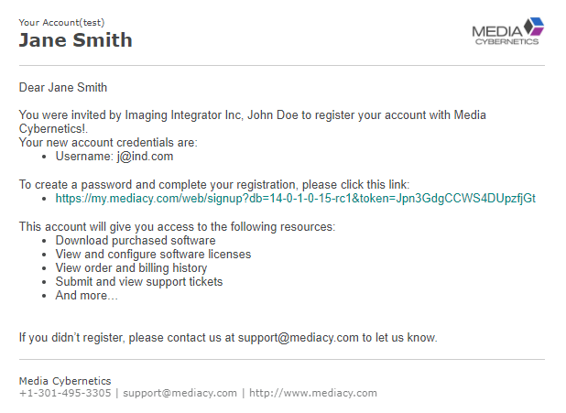
1) Invite End User to Register for Account
CONFIDENTIAL
Notes:
This is an example of the email sent to the End User. They simply need to click the Link. The email will show as sent from “Media Cybernetics” and the email will be “support@mediacy.com”.

Slide 32
CONFIDENTIAL
Notes:
After the End User clicks the link in the email, they will be guided through a Registration process. Upon first login they can navigate to their profile and update any missing information. They can also check the Company information, add team members, see Plans and Products, any Orders and Invoices if they purchased directly from MediaCy, and finally support tickets.

Slide 33
1) Invite End User to Register for Account
Partner view AFTER End User completes Registration
CONFIDENTIAL
Notes:
After the End User registers and signs in for the first time, the Partner will see a status of “Active”. This means products can be E-Delivered to the End User now.

Slide 34
Step 2 Shop for Products & eDeliver to your Account
CONFIDENTIAL

Slide 35
CONFIDENTIAL
Notes:
In this video, the partner clicks on the Shop page and opens a Product by clicking the name of the Product. A full-page view appears, and they can click “Add to Cart”. If there are more items to add, click “Continue Shopping” and add what is needed.
There are no dependencies for shopping, any product can be added to the cart.
Once all products are added, click next to review Billing, Shipping (if dongles are added), and Payment options. On the last step, Partners can add a Purchase Order reference number. If credit terms are approved, choose Pay by Invoice or choose to Pay by Credit Card now. After Confirming an order, a summary page will appear. Go to the Order and review the details. Here you can print and Download the Order. You can also see the Invoice associated with the Order and Pay by Credit Card directly form the Invoice.
Once an order has been placed, and approved by MediaCy, the products will be placed on the “Pending Action” page, ready to be E-Delivered.

Slide 36
Step 3 eDeliver Products to Registered End User Admin
CONFIDENTIAL

Slide 37
eDeliver to End User
1
2
“Pending
Action” Page
Select
Products
Click
E-Deliver
Select End User Account
Confirm
E-Delivery
Partner
End User
Click Link in Email
View
Products
Sign In

Slide 38
CONFIDENTIAL
Notes:
In this video, software licenses were purchased by the Partner. The purchased Licenses will always be delivered to the partner first and will be accessible from the “Pending Action” page. To E-Deliver the products, select the checkbox on the right side and then click E-Deliver.
Here a Partner enters the email address of an ACTIVE admin contact previously invited to register. Click Confirm E-Delivery. Once delivered, the product licenses will be moved to the “Completed” page along with the Contact name and Company. All bundled modules will be included inside the bundle, all loose modules will be in the same list.
Now, signing in as Jane Smith, the End User, we can see the Software was delivered to the “My Products” page and the “Upgrade Protection Plan” was delivered to the “My Plans” page. The Upgrade Protection Plan will be delivered without a connection to any particular license. The End User should be instructed to “Choose a Bundle” and select the Bundle to be associated with.

Slide 39
End User
Product Bundling, Download, & Linking
CONFIDENTIAL

Slide 40
Download, Install, Link
1
2
View Products
Reconfigure Bundles
Download Software
Install
my.MediaCy
Launch License Manager
Link Licenses to Target
Local Computer
3

Slide 42
Notes:
In this video the End User downloads the software from the Products page of their account and installs the application.

Slide 43
Notes:
In this video the End User launches Image-Pro v11 for the first time, signs in their myMediaCy account, and links the newly purchased license.

Slide 44
Addition Documentation
CONFIDENTIAL

Slide 45
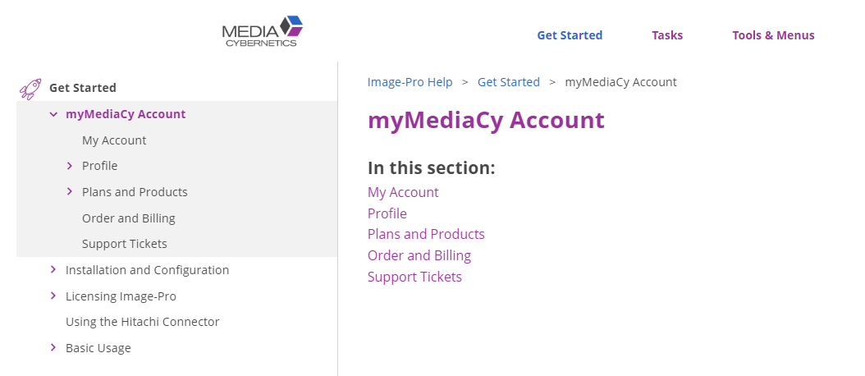
Help
https://help.mediacy.com/Image-Pro/11/en/Content/A_Get_Started/myMediaCy%20Account.htm
CONFIDENTIAL

Slide 46
Selling & Delivering Image-Pro v11
Distribution Partner Training
CONFIDENTIAL

